Slide 1

ChatGPT Tweets Sentiment Analysis

Slide 2

INTRODUCTION
What is ChatGPT Tweets Sentiment Analysis?
Positive or negative ideas, feelings, and judgments are all examples of sentiments.
With the use of several papers, we evaluate text to determine the writer's feelings in either positive or negative remarks, inquiries, and demands.
The goal of this sentiment analysis project is to use cutting-edge NLP approaches to quickly and effectively evaluate and classify the sentiments expressed in tweets about ChatGPT on Twitter.
Its vital for understanding public perception, monitoring brand reputation, leveraging customer feedback, and adapting marketing strategies, ultimately enabling real-time insights and informed decision-making.

Slide 3
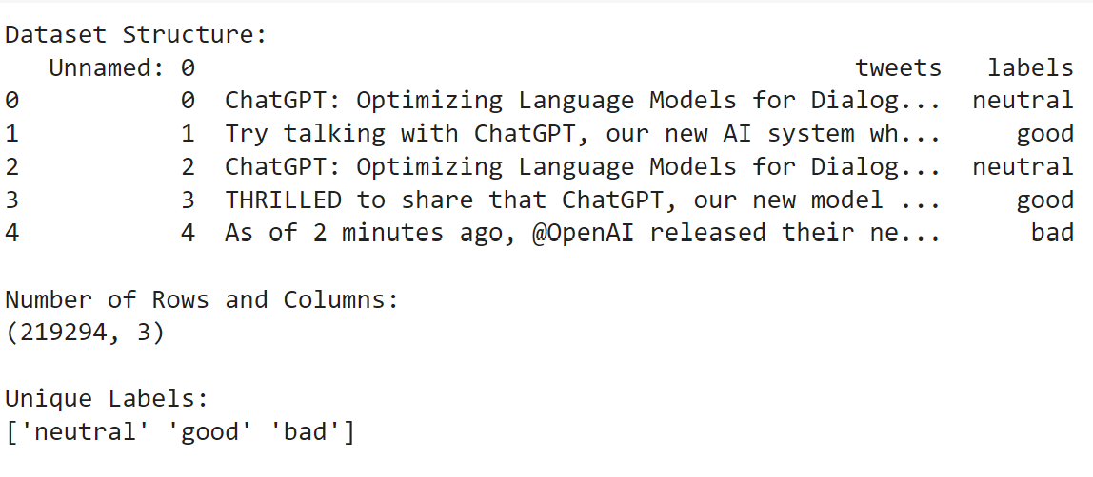
What’s in Dataset?
The dataset structure has 3 labels, with 217622 collection of tweets.
Each tweet specifies the opinion of various users and their own personal experience with chatgpt.
https://www.kaggle.com/datasets/charunisa/chatgpt-sentiment-analysis - Dataset.

Slide 4
Data preprocessing

Slide 5
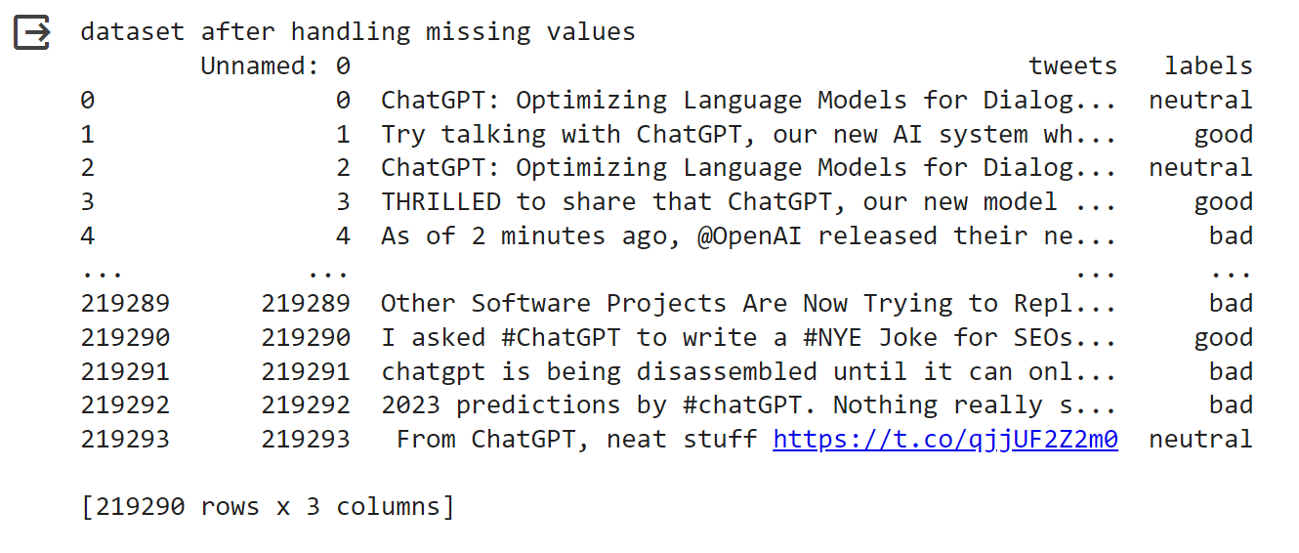
Remove Missing Values
Removing missing spaces ensures data integrity and consistency in text data, thus preventing errors.

Slide 6
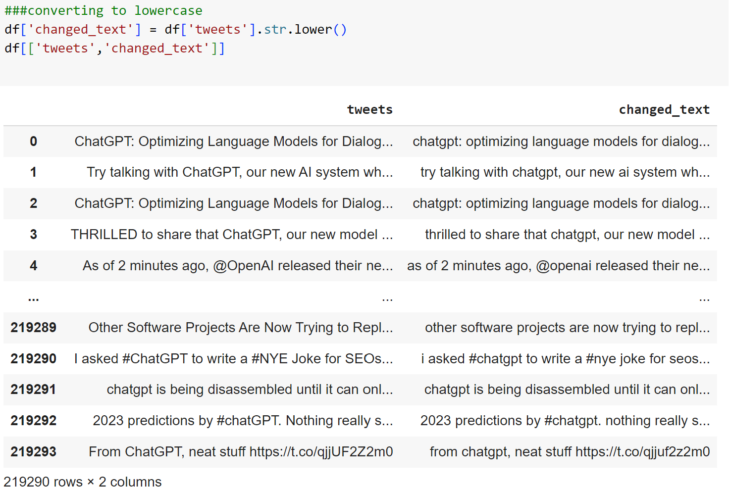
Convert to Lowercase
Another important preprocessing method is converting into lowercase as it :
standardizes text
removes case variations, prevents duplication of words
simplifies text processing.

Slide 7
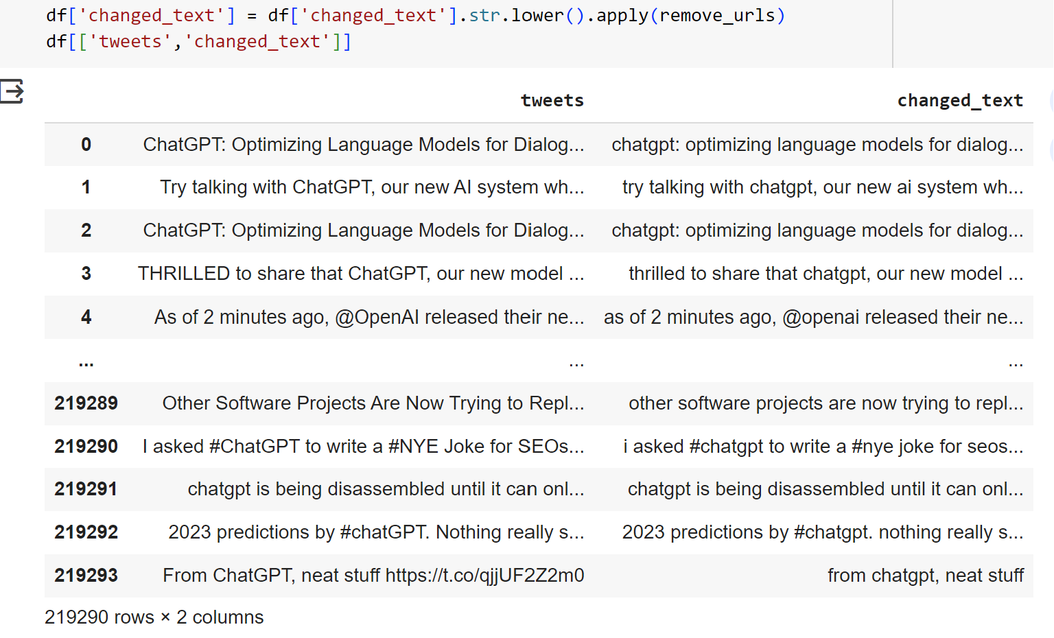
Remove URL’s
Eliminating URLs improves data cleanliness and readability, as URLs can be long, complex, and disruptive to text analysis and processing.

Slide 8
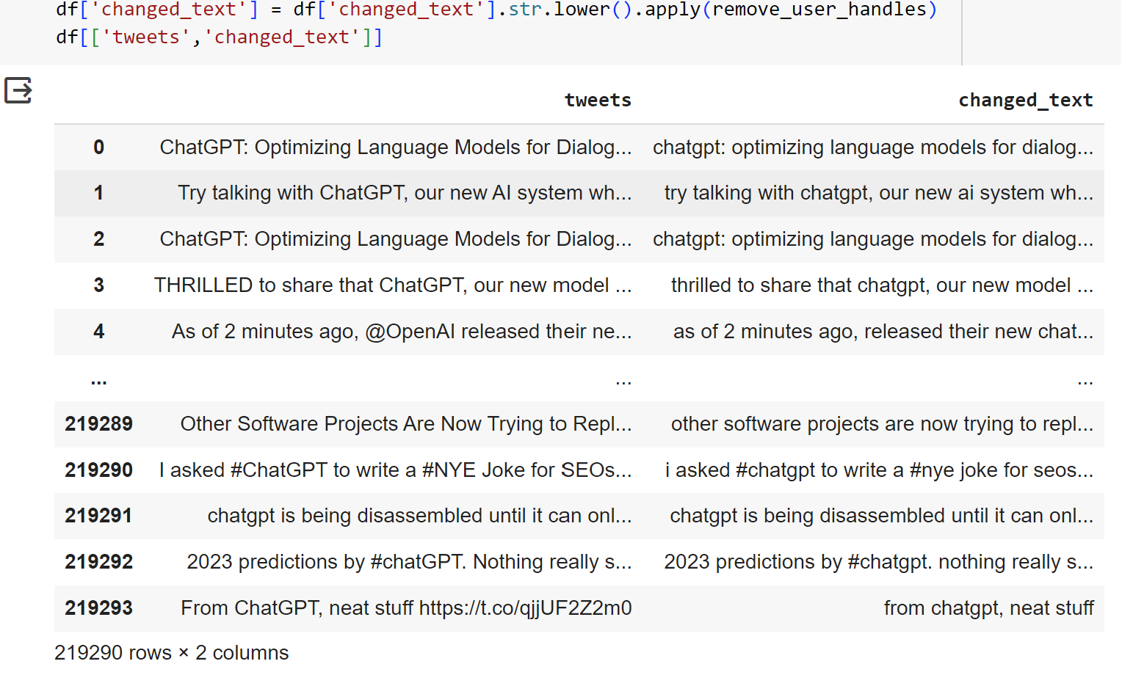
Remove user handles
Removing user handles from text data helps standardize the text, making it lot more consistent and more suitable for analysis.

Slide 9
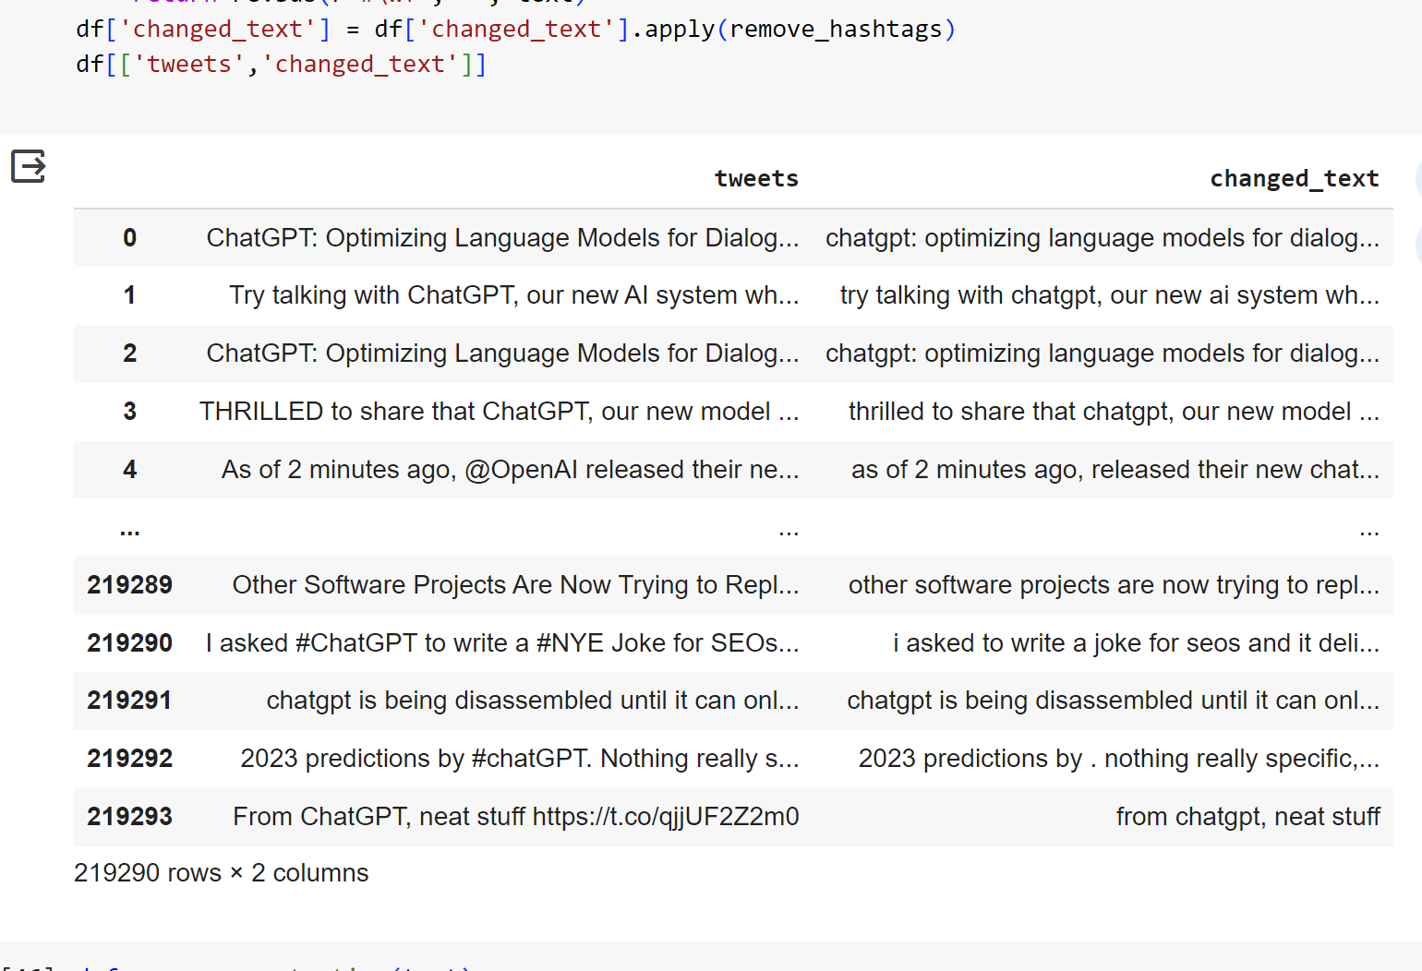
Remove Hashtags
Eliminating hashtags from text data improves readability and clarity.
It ensures that the text can be easily understood and analyzed without the distraction of hashtags.

Slide 10
Remove punctuation
Removing punctuation marks standardizes the text by eliminating non-alphanumeric characters, making it easier to analyze and compare text data accurately.

Slide 11
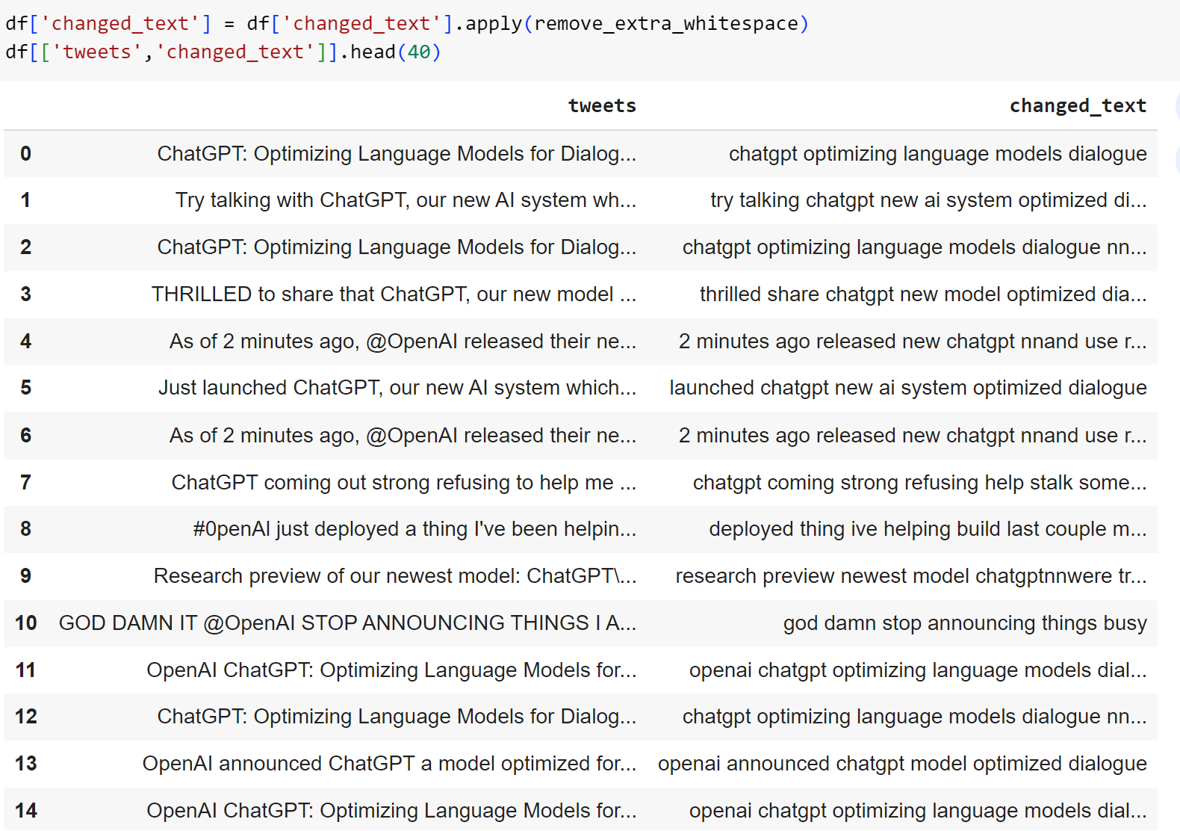
Remove white spaces
Eliminating extra white spaces ensures consistent formatting and tokenization in text data, which is crucial for accurate analysis and interpretation.

Slide 12
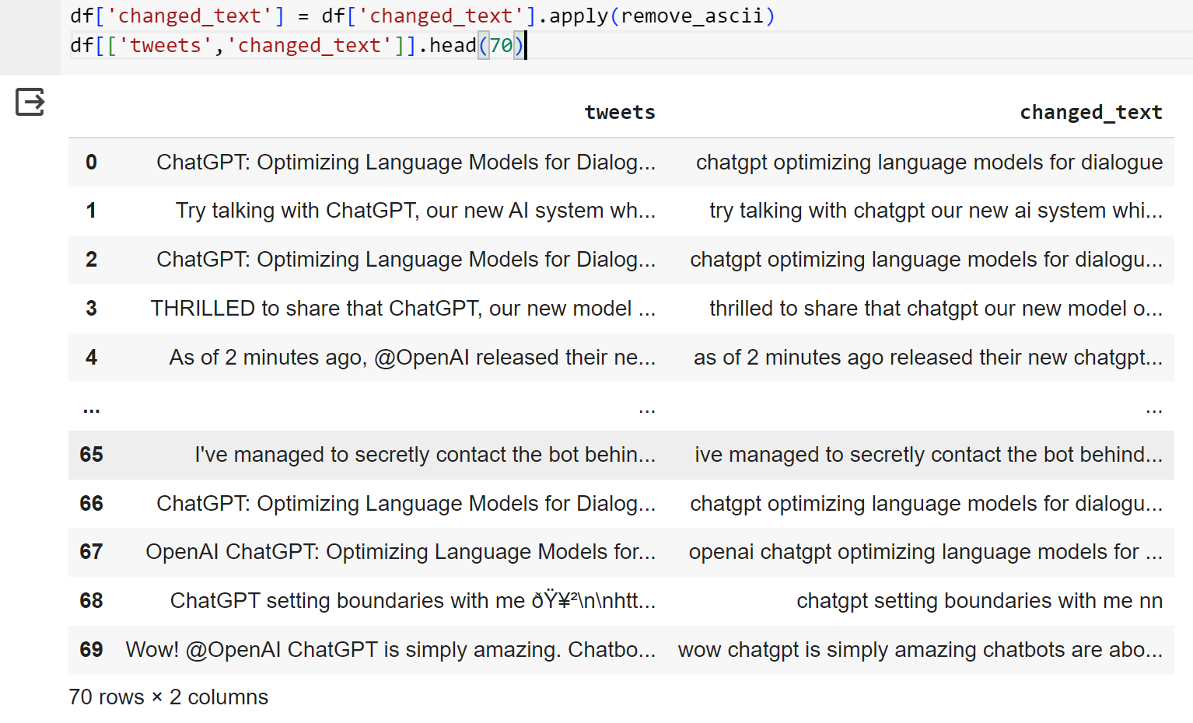
Remove Ascii characters
Removing ASCII characters ensures that text data remains within the desired character encoding, thus preventing data corruption and ensuring data integrity during processing.

Slide 13
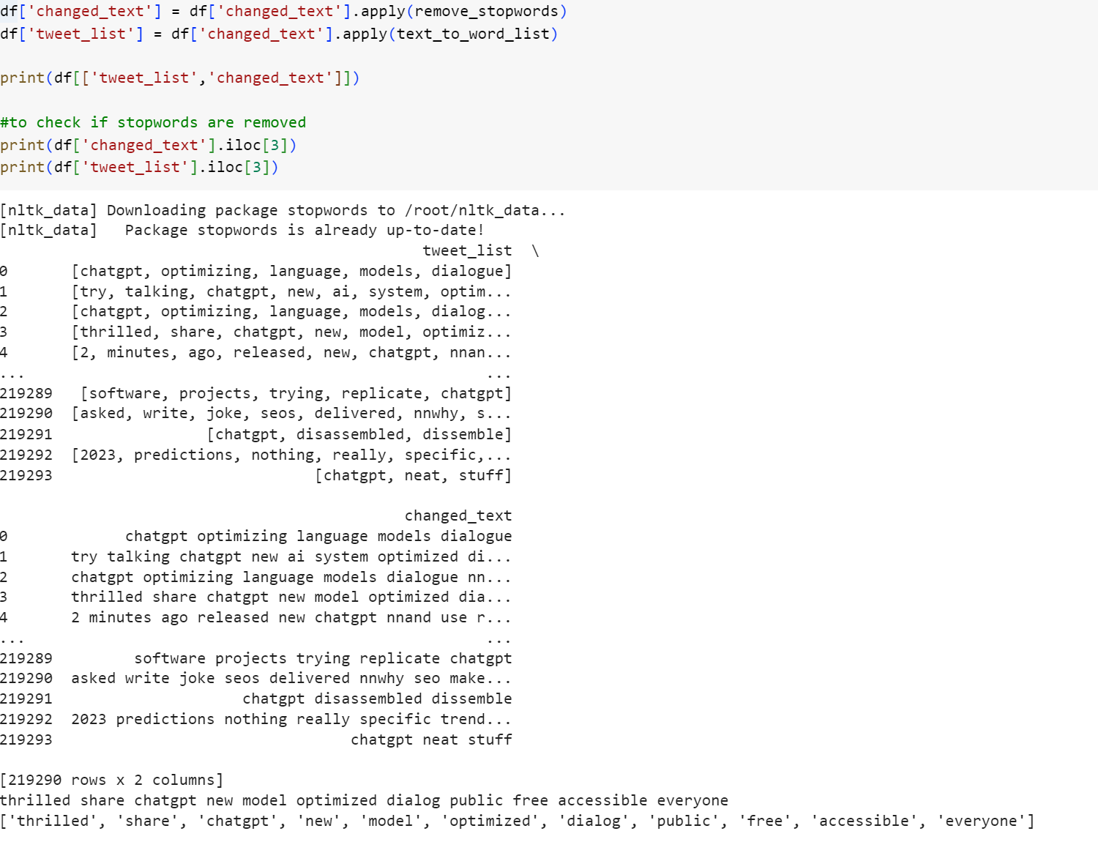
Remove Stopwords
Removing stop words from text data focuses analysis on content-rich words, improving the relevance of extracted information and insights.
Here, we have used NLTK(Natural language toolkit) a popular python library for NLP tasks.
We downloaded the set of stopwords for english language, because during analysis its important that we are working with standardized and widely accepted stop words in English.

Slide 14
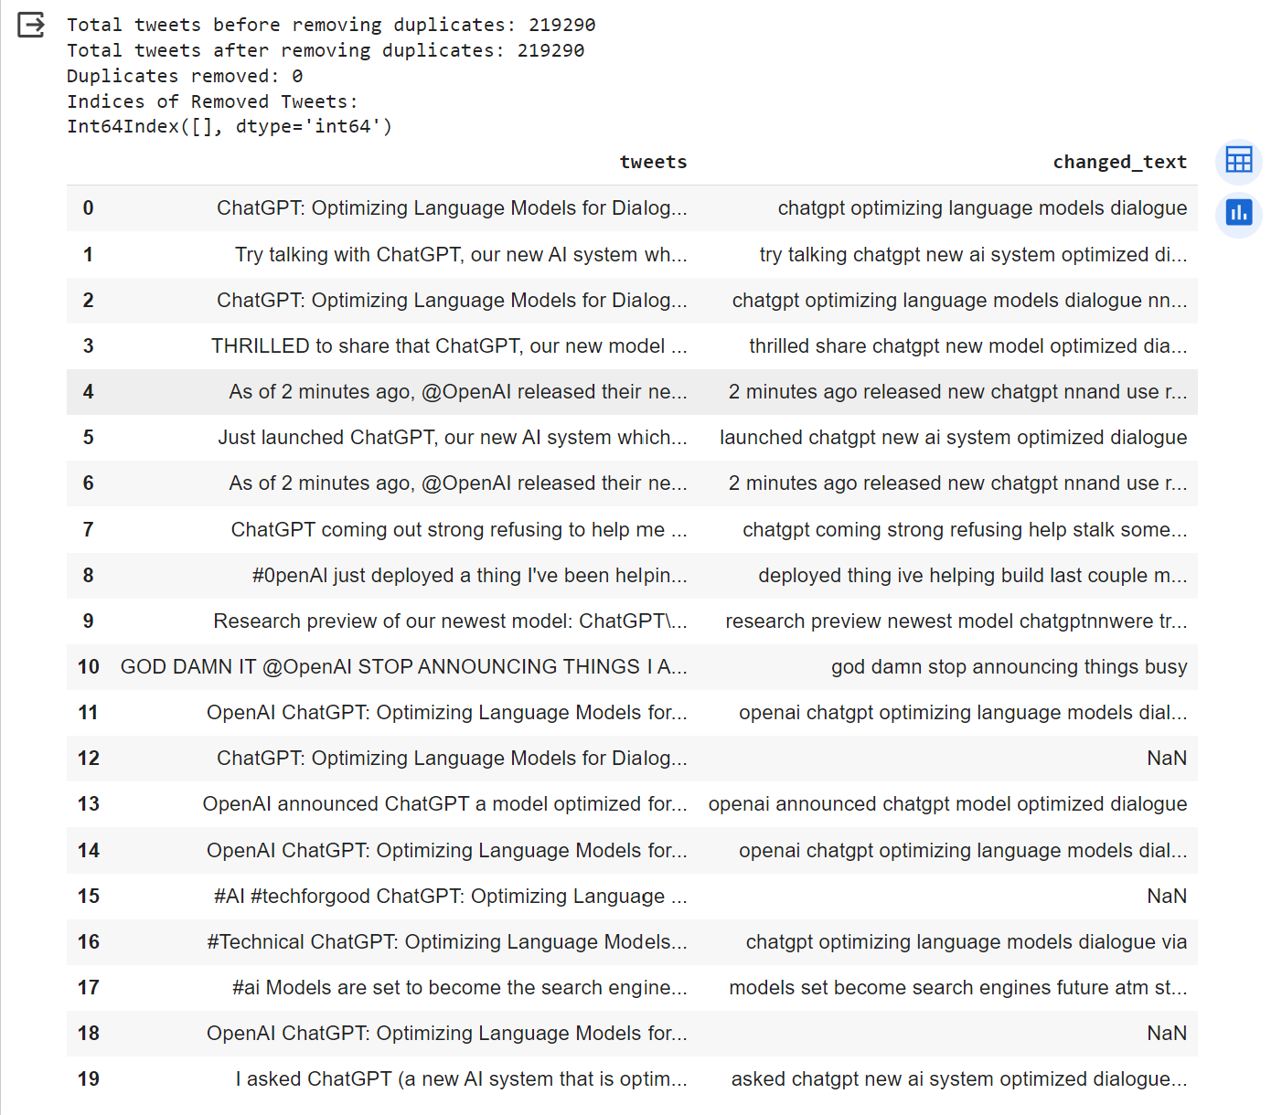
Remove Duplicates
Removing duplicates to ensure it accurate analysis is done.

Slide 15
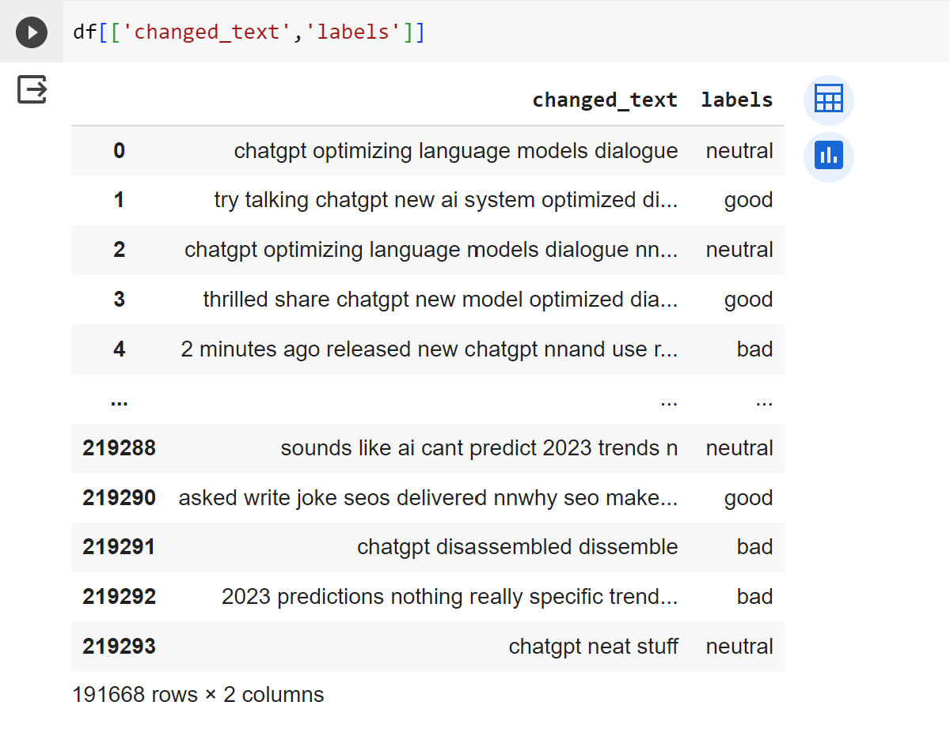
Dataset with Sentiment

Slide 16
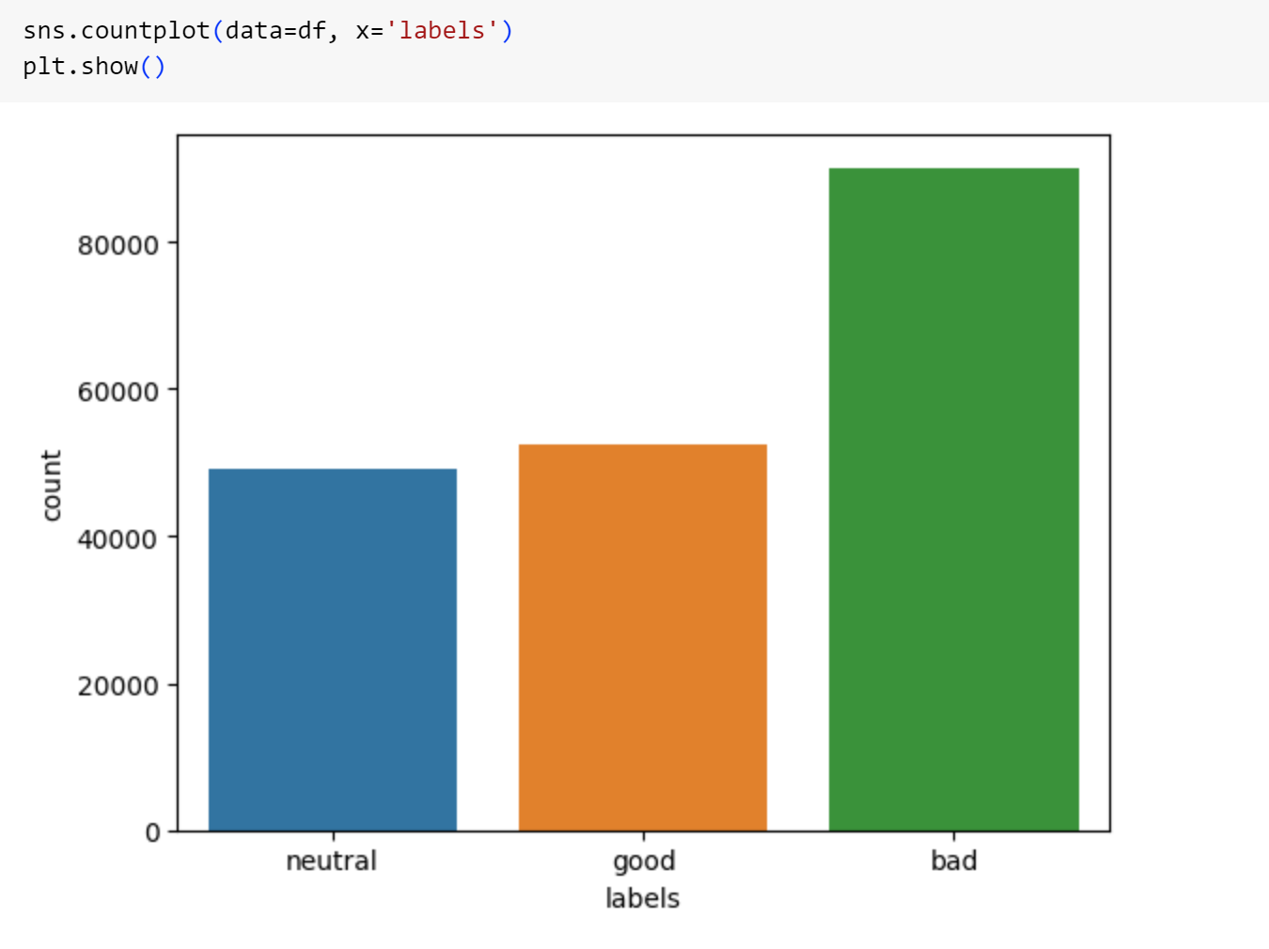
COUNT PLOT OF TWEETS SENTIMENTS

Slide 17
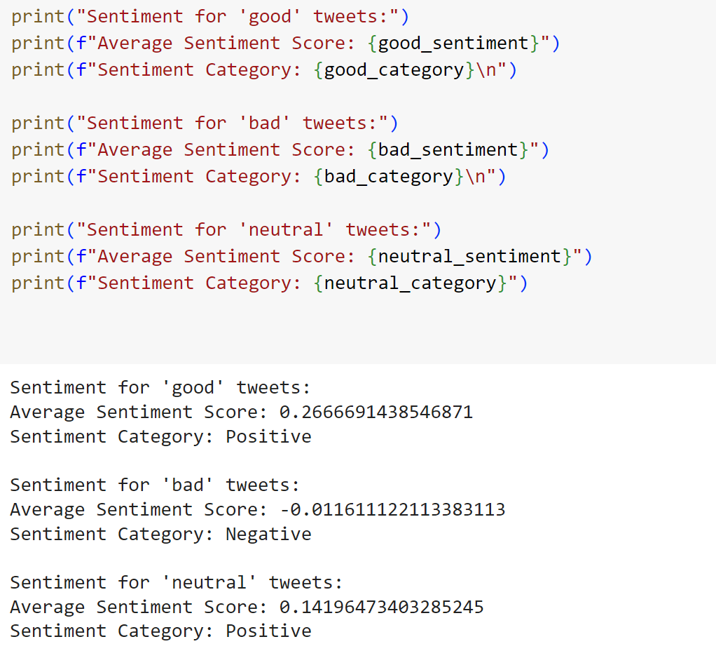
Finding Sentiment and Scores

Slide 18
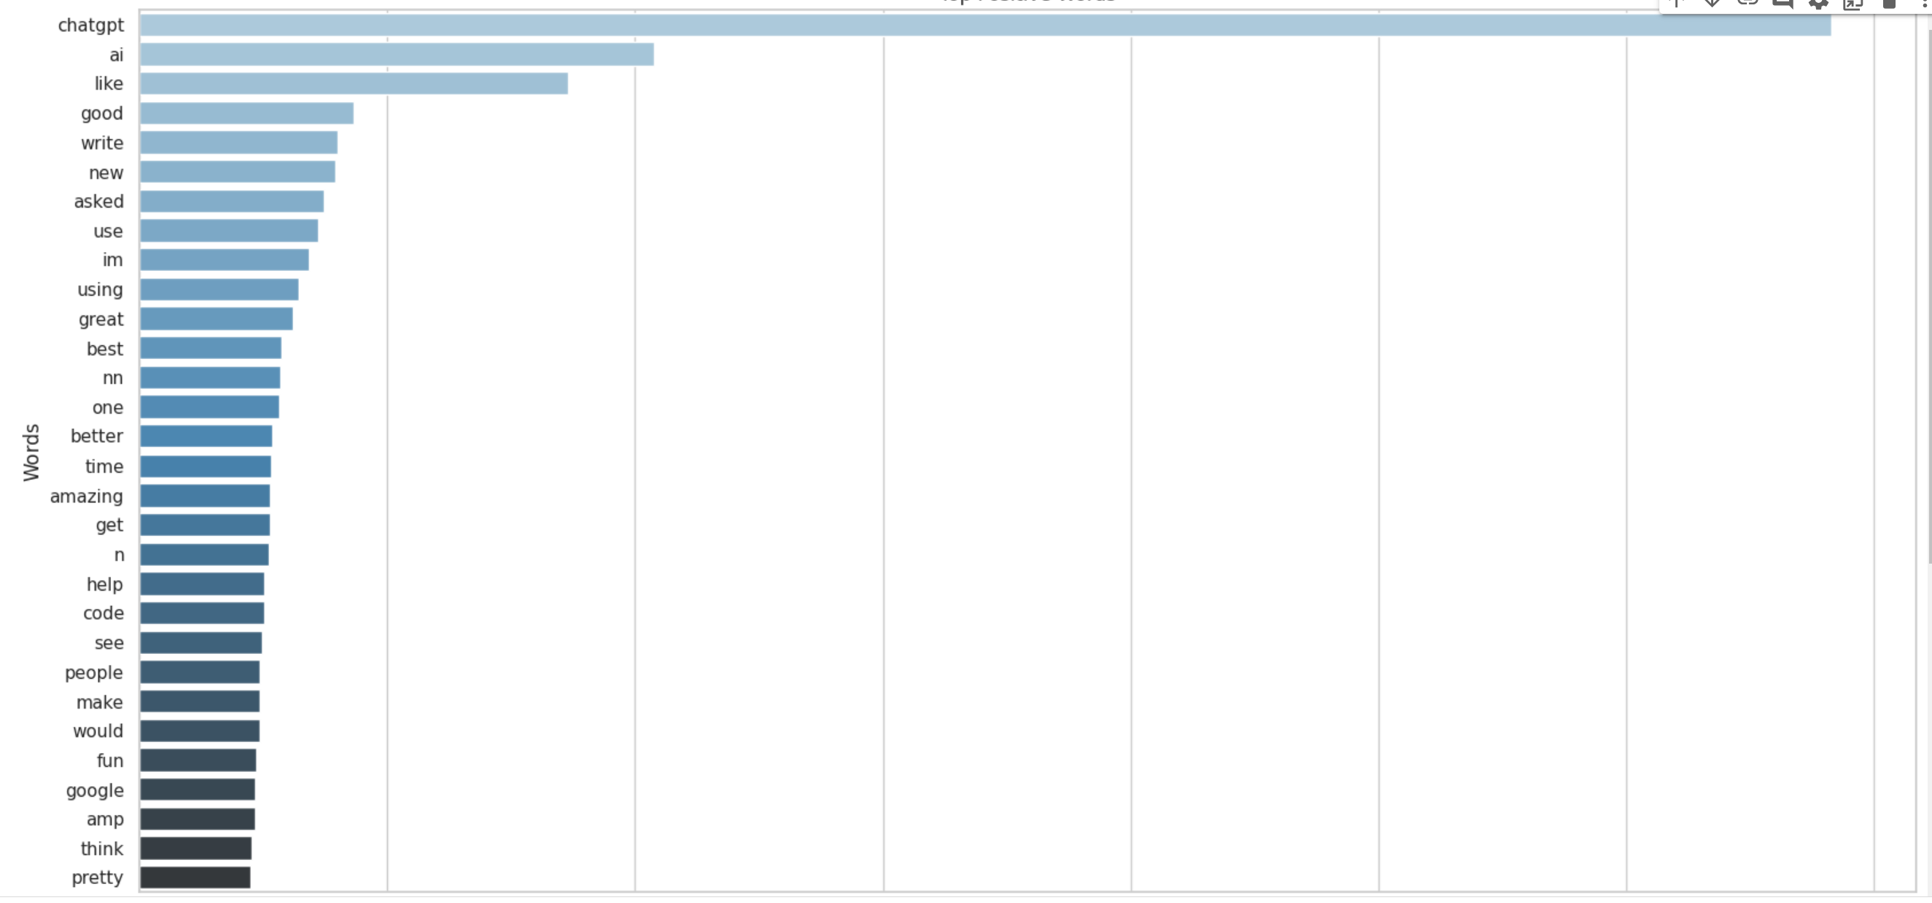
Bar Plot – Good Tweets

Slide 19
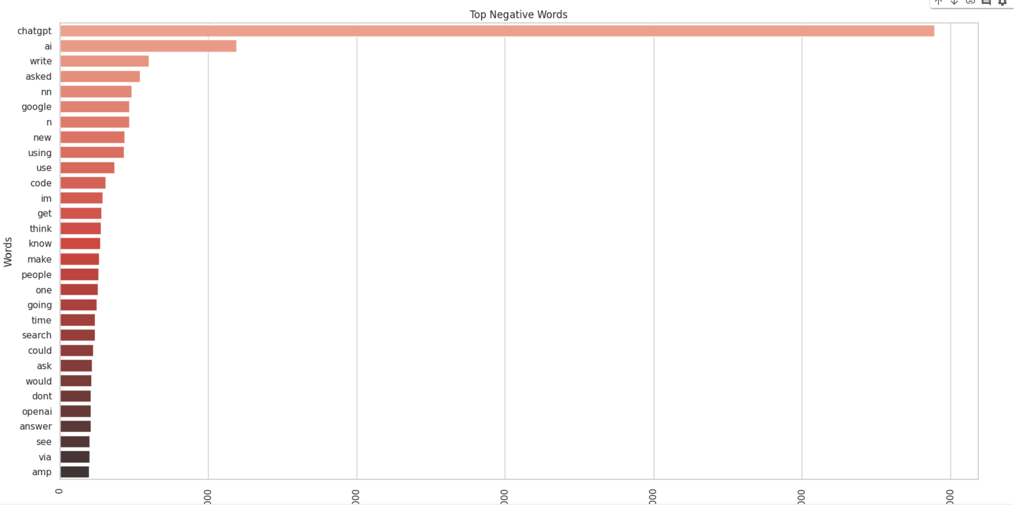
Bar Plot – Bad Tweets

Slide 20
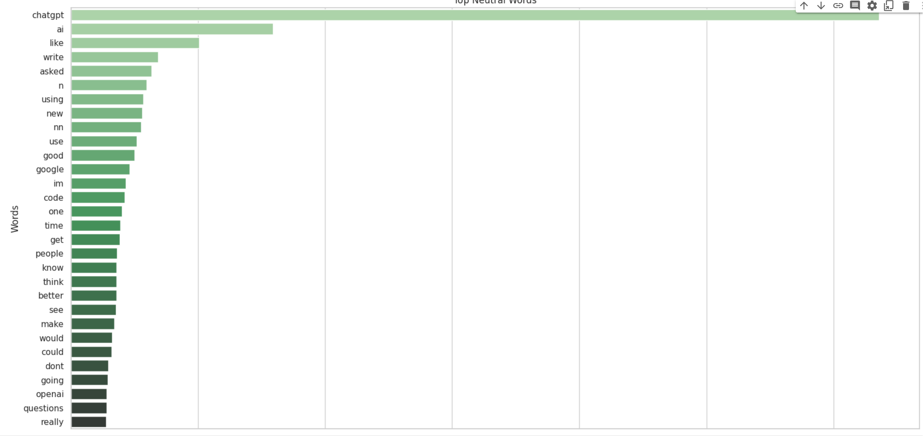
Bar Plot – Neutral Tweets

Slide 21
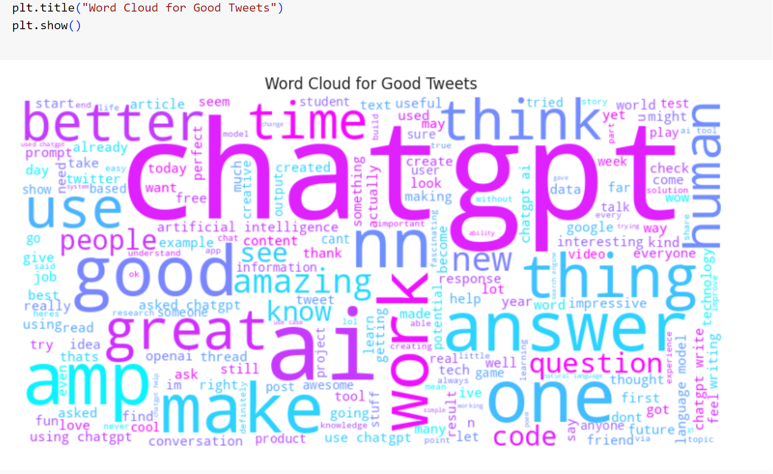
Word Cloud - Good Tweets
Word Cloud is used to display the maximum frequency of words with the good_tweet_word list.

Slide 22
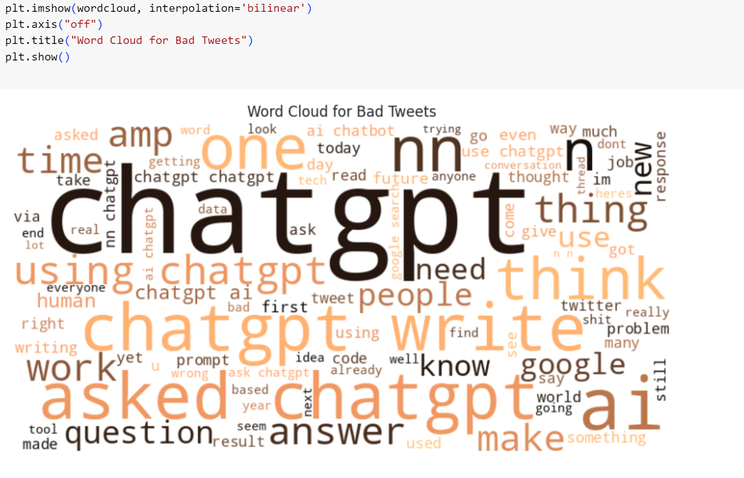
Word Cloud - Bad Tweets

Slide 23
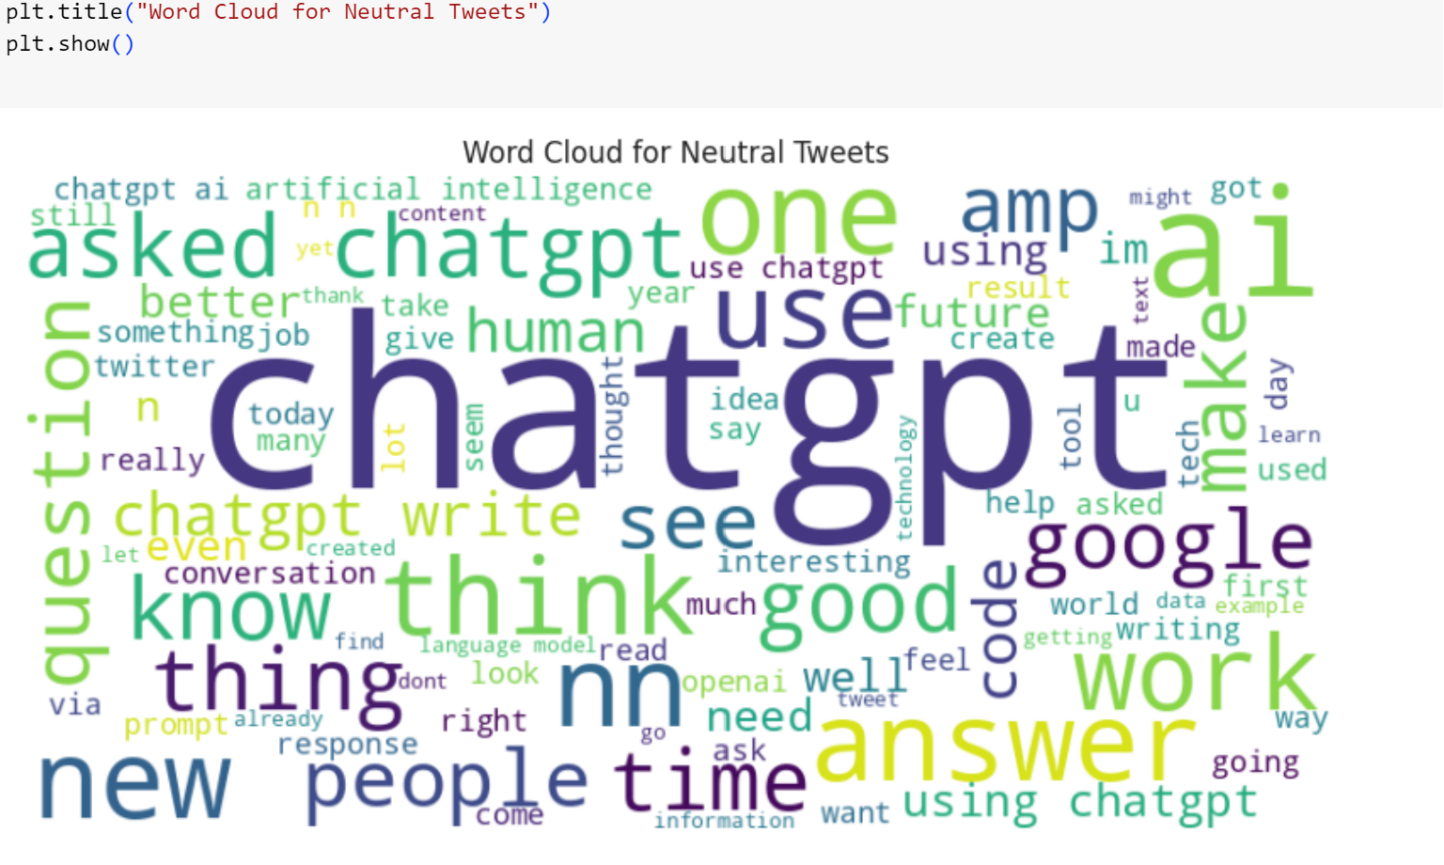
Word Cloud - Neutral Tweets

Slide 24
Long Short-Term Memory (LSTM)
Recurrent neural networks of the Long Short-Term Memory (LSTM) type can recognize order dependence in sequence prediction tasks.
With the help of structures known as gates, the LSTM capable to carefully control what information is added or removed from the cell state.
LSTMs are purposefully made to circumvent the issue of long-term reliance. For them, retaining knowledge for extended periods of time is almost automatic, not something they struggle to learn.
Information can be optionally allowed via gates. They consist of a pointwise multiplication operation and a sigmoid neural net layer.
Numbers ranging from zero to one are produced by the sigmoid layer, which indicate how much of each component should pass through.

Slide 25
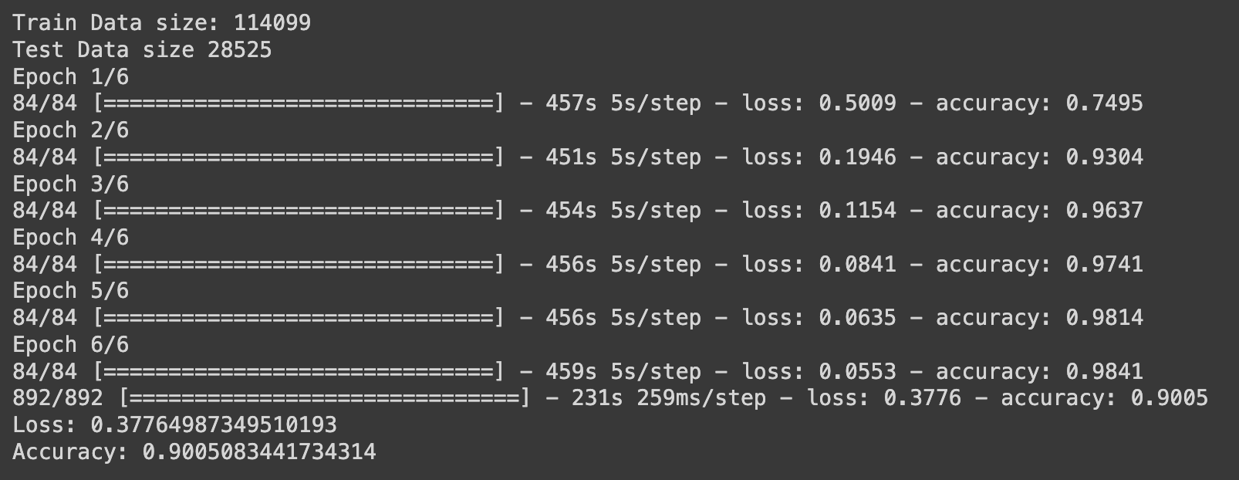
MODEL EXPLANATION AND ACCURACY SCORE
Generate train and test data for the dataset and then converted the string data into numeric values using Label Encoder.
As the dataset is large considered 10000 words of vocabulary to reduce the run time of the program.
Used LSTM model to fit data and gain accuracy.
Image shows the train and test data size along with the model accuracy.

Slide 26
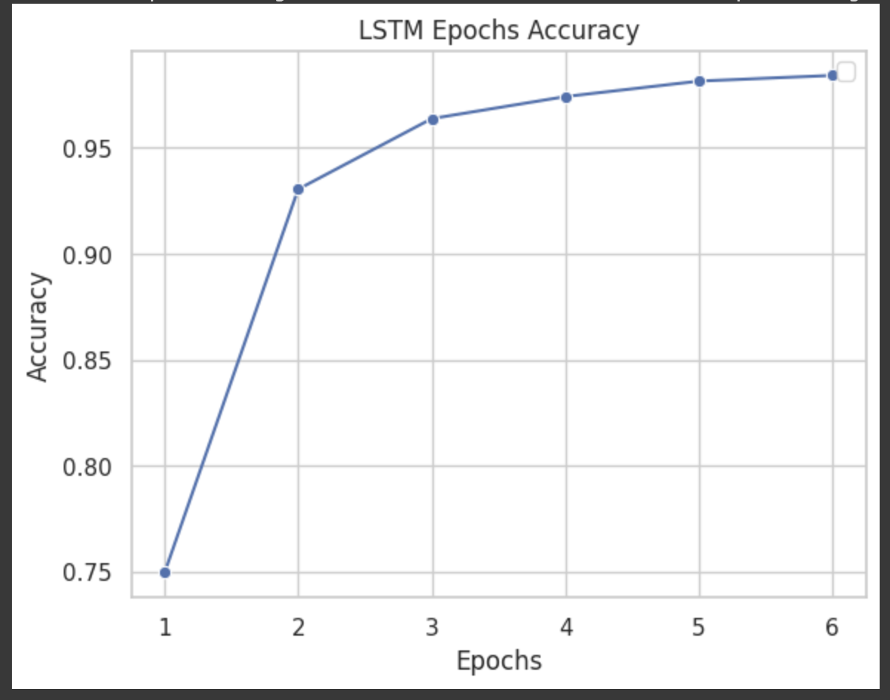
ACCURACIES OBTAINED FOR EACH EPOCH FOR LSTM Model

Slide 27
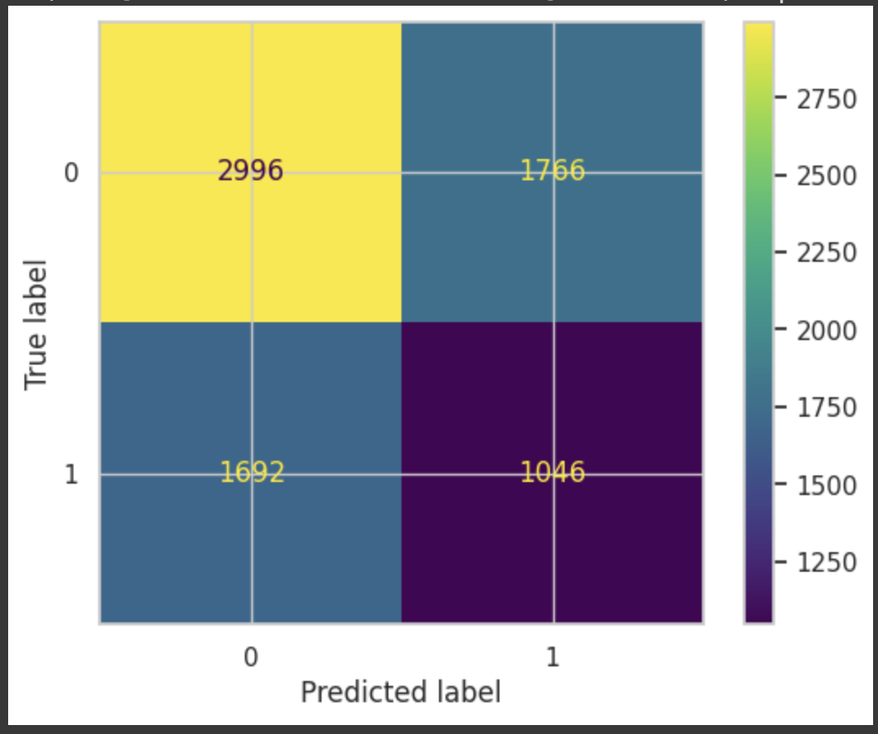
CONFUSION MATRIX

Slide 28
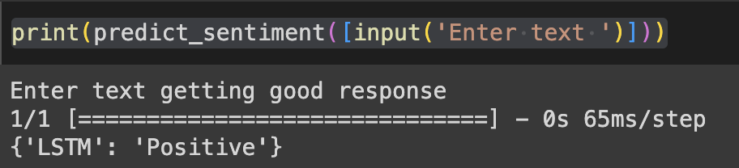
PREDICTING THE SENTIMENT OF A SENTENCE

Slide 29
Bi-Directional Long Short-Term Memory (LSTM)
Recurrent neural network architecture that processes input sequences in both forward and backward directions.
Unlike LSTM Model which considers only past information, bidirectional LSTM models capture data from both past and future time steps.
Information flow through the model is controlled by gating mechanisms, which include a pointwise multiplication operation and a sigmoid neural network layer.
The sigmoid layer produces values between zero and one, indicating how much of each component from both directions should contribute to the final output.
Enhances the model’s ability to capture long-range dependencies and improves its performance in various sequential tasks.
Few use-cases where this model can be used is sequence prediction, natural language processing, etc.

Slide 30
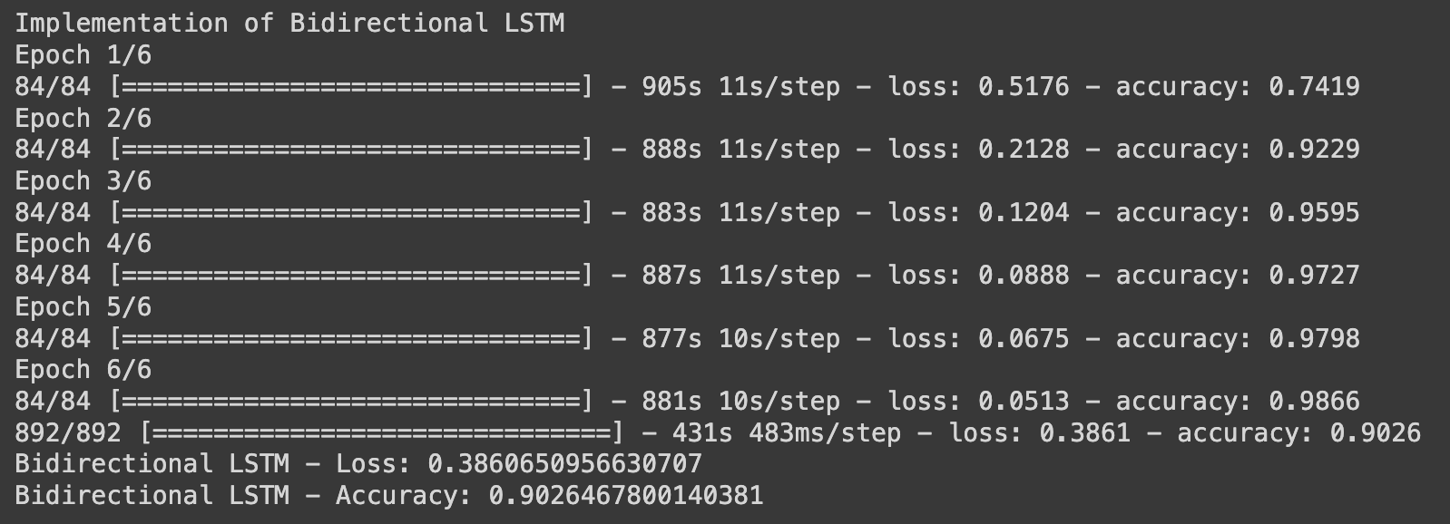
MODEL EXPLANATION AND ACCURACY SCORE
Generate train and test data for the dataset and then converted the string data into numeric values using Label Encoder.
As the dataset is large considered 10000 words of vocabulary to reduce the run time of the program.
Used Bidirectional LSTM model to fit data and gain accuracy.
Image shows the accuracy and loss values for each epoch along with overall loss and accuracy

Slide 31
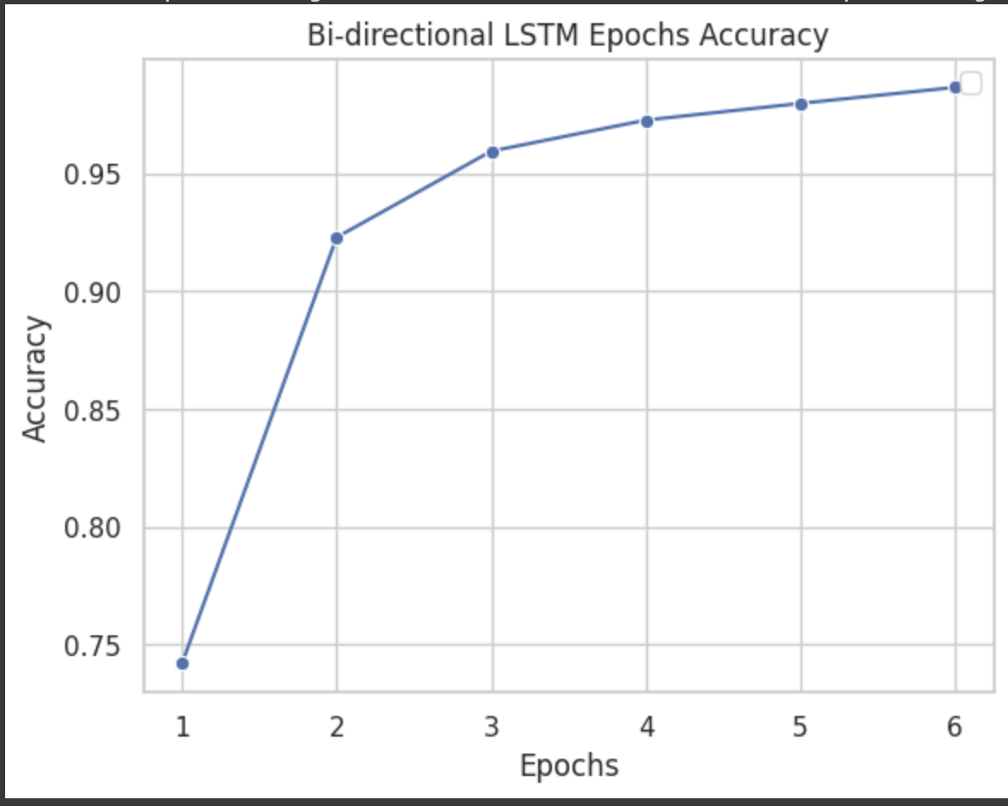
ACCURACIES OBTAINED FOR EACH EPOCH FOR Bi-Directional LSTM Model

Slide 32
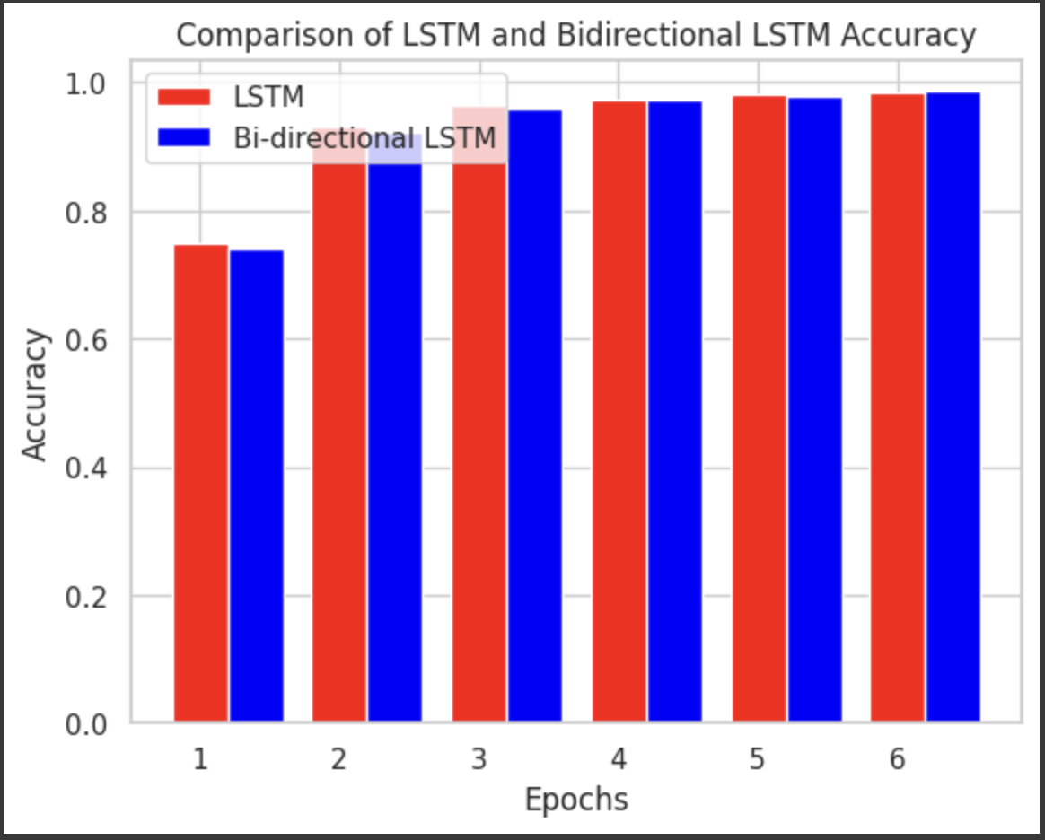
COMPARISON OF ACCURACIES FOR EACH EPOCH FOR LSTM AND BI-DIRECTIONAL LSTM MODEL

Slide 33
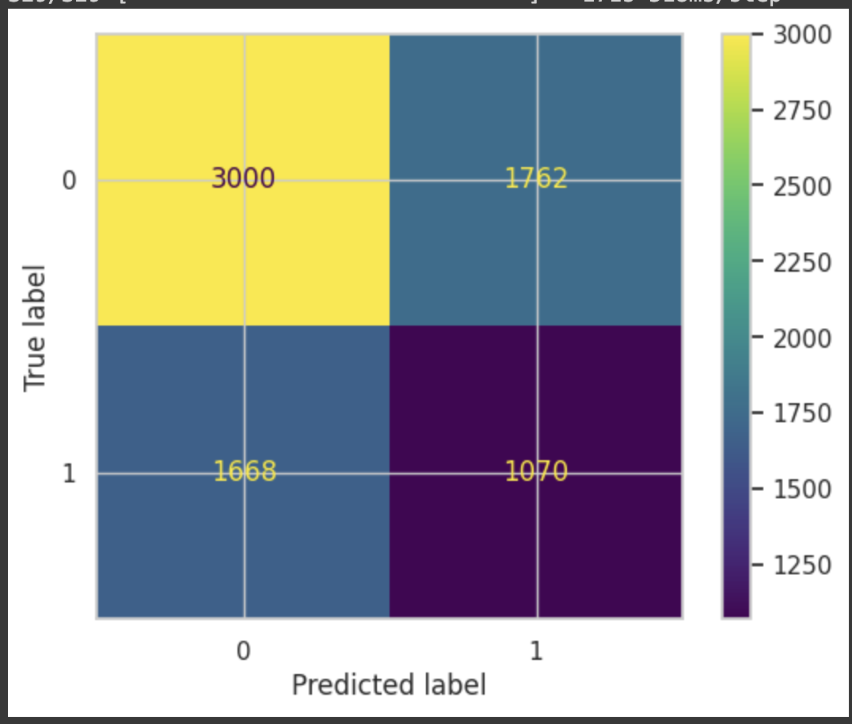
CONFUSION MATRIX

Slide 34
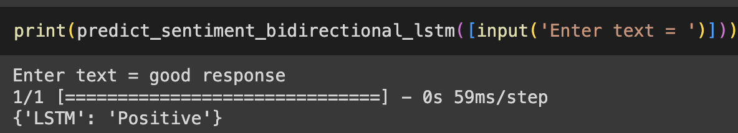
PREDICTING THE SENTIMENT OF A SENTENCE

Slide 35
XLM-T( Cross-Lingual Language Model) Model
Transformer-based neural network designed for natural language processing tasks.
Engineered to understand and process language across multiple languages. It achieves this through various key components and training objectives:
Masked Language Modeling: The model is pre-trained using MLM model and it learns to predict the masked or hidden tokens within a sentence.
Translation Language Modeling: Used to understand the relationships between sentences in different languages. Helps model to generalize its understanding of language across diverse linguistic contexts.
Cross-Lingual Natural Language Inference: Model is trained to determine whether a given sentence is positive, negative or neutral to another sentence.
Dimensionality: It is denoted as xlm-mlm-tlm-xnli15-1024, just indicates the model has a hidden layer of 1024 dimensionality.

Slide 36
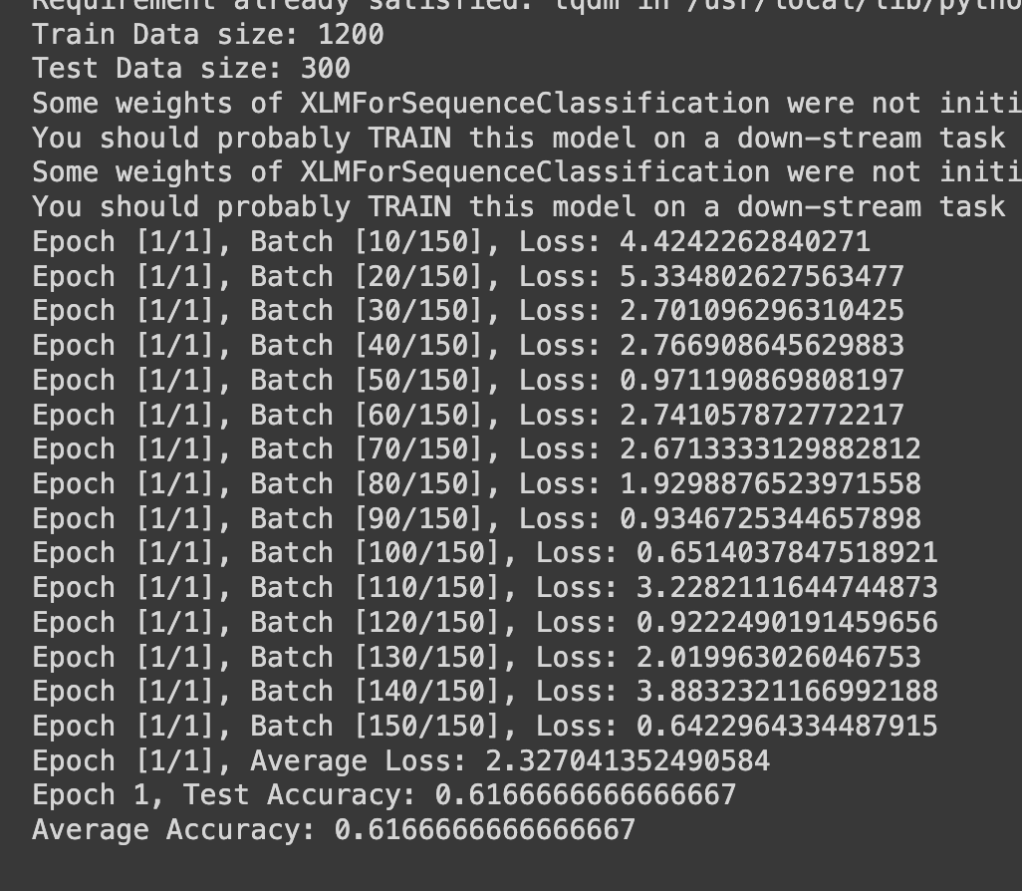
MODEL EXPLANATION AND ACCURACY SCORE
Generate train and test data for the dataset and then converted the string data into numeric values using Label Encoder.
As the dataset is large considered 1500 words of vocabulary to reduce the run time of the program.(The program is taking more than 3hrs to run for the data considered).
Used XLM model to fit data and gain accuracy.
Image shows the train and test data size along with the model accuracy.

Slide 37
CONCLUSION
In the comparison between LSTM and Bidirectional LSTM models, the Bidirectional LSTM demonstrated higher accuracy by 0.21 for 10,000 labels, even though the difference was marginal. A more extensive dataset would be necessary to conclusively determine the superior model.
For the XLM model, it was trained on a comparatively smaller dataset than the others. Therefore, it is challenging to make a definitive comparison to ascertain its overall effectiveness.

Slide 38
THANK YOU
“Unlocking ChatGPT: Deciphering Twitter's Sentiments”

